Slide 1



Team Details
Team name: Zero Context
Team leader name: Saubhagya Ashish
Problem Statement: Retail & Commerce. Online stores use dark patterns (fake countdowns, items sneaked into the cart, fees revealed only at payment) that make shoppers pay more than they agreed to. India's CCPA bans 13 such patterns, yet nobody audits the whole journey the way a shopper experiences it.
Dark patterns? Caught in 4K.
AI agents that shop like you
shop-honest-ai.web.app
Notes:
Team Zero Context (leader: Saubhagya Ashish). Shop Honest: AI agents shop an online store like a real customer and report every dark pattern with evidence, the rule it breaks, what it costs the shopper and a fix.

Slide 2









Brief about the idea
THE IDEA
THE PROBLEM
AI agents shop like a real customer, and hand you the receipts.
₹1,499 → ₹1,894
Same earbuds. Insurance sneaked into the cart, a pre-ticked membership and fees shown only at payment. The price you see isn't the price you pay.
Product
Variant
Cart
Checkout
Payment
52 of 53
top Indian apps use deceptive design
ASCI, 2024
Every finding comes with
Screenshot evidence
The exact rule broken
13
dark patterns banned by India's CCPA
Guidelines, 2023
3 months
What it really costs
A specific fix
for platforms to self-audit for them
CCPA advisory, June 2025
Notes:
Problem: dark patterns make shoppers pay more than the price they saw. In our demo store the page says ₹1,499 and payment asks ₹1,894. ASCI found deceptive design in 52 of the top 53 Indian apps (2024); CCPA's 2023 guidelines ban 13 patterns, and its June 2025 advisory asked e-commerce platforms to self-audit within 3 months. Idea: Shop Honest's agents walk product → variant → cart → checkout → payment like a shopper and report each trick with screenshot evidence, the rule, the money impact and a fix.

Slide 3
Opportunities
1
How is it different from existing ideas?
2
How will it solve the problem?
3
USP of the proposed solution
■ Walks the whole journey in a real browser, product to payment, instead of scanning one page or one piece of text.
■ Measures, doesn't guess: reloads to catch restarting timers, compares cart with page, spots fees that appear only at payment.
■ Checks the MRP against real price history in BigQuery.
■ Platforms: self-audit before the regulator does, as CCPA asked in June 2025.
■ Regulators & consumer groups: evidence at scale, with screenshots, rules and ₹ impact.
■ Shoppers: see the real price and every trick before paying.
■ Proof, not opinions: every claim cites a measured page element and a second AI double-checks it; unsure claims go to a human.
■ Speaks money and law: "+₹395 per order", the rule broken in 7 regions, and a fix for each finding.
■ Honest about limits: stops at sign-in walls and bot protection, and says what it couldn't see.
Proof it works: 9/9 planted tricks caught · 0 false alarms · 0.962 F1 zero-shot on 2,356 public shopping texts
Notes:
Different: a whole-journey, measured audit in a real browser, not a single-page or text scan. Solves: platforms can self-audit, regulators and consumer groups get evidence at scale, shoppers see the real price. USP: every claim is grounded on a measured element and double-checked, findings come with ₹ impact, law and fixes, and partial audits say what they couldn't see.

Slide 4





List of features offered by the solution
01
02
03
04
Live agent walkthrough
Measured checks
Price Historian
Pattern Analyst
Watch agents shop in a real browser, narrating every step as they go.
Restarting timers, frozen stock, sneaked items, pre-ticked boxes, late fees.
BigQuery price history exposes "MRPs" the product never sold at.
Gemini reads each screen for shaming, lopsided buttons and fake claims.
05
06
07
08
Adjudicator + review
The real bill
Law & fixes
Reports for any store
A second Gemini check on the evidence; unsure claims go to a person.
Price seen vs. price charged, the true saving, overcharge at scale.
The rule broken in India and 6 more regions, real penalties, one fix each.
Trust score, PDF report; audits real stores logged out, replays for free.
Notes:
Eight features: live walkthrough, measured checks, Price Historian on BigQuery, Gemini Pattern Analyst, Adjudicator with a human review queue, the real bill, law and fixes across 7 regions, and reports/PDF for any store.

Slide 5





Process flow diagram or Use-case diagram
THE JOURNEY a logged-out shopper, in a real browser
Product
Variant
Cart
Checkout
Payment
look, reload, look again
switch size or colour
what got added?
pre-ticked? hidden options?
late fees · never pays
Sign-in wall or bot protection? Stop, and report what it saw.
ON EVERY SCREEN measure first, then let Gemini judge, then double-check
Capture
Measured checks
Pattern Analyst
Evidence rules
Adjudicator
Verdict
screenshot + every element measured
timers, stock, cart, fees, prices
Gemini reads wording and design
must cite a measured element
Gemini re-checks a crop of it
confirmed · review · dropped
Report trust score · the real bill · legal exposure in 7 regions · a fix for every finding · PDF
Notes:
The navigator walks five steps like a logged-out shopper and stops honestly at sign-in walls or bot protection. On every screen: capture a screenshot and measure every element, run measured checks, let Gemini (Pattern Analyst) judge wording and design, apply evidence rules, re-check with the Adjudicator, then confirm, send to human review, or drop. The Reporter turns findings into the trust score, money, law and fixes.

Slide 6
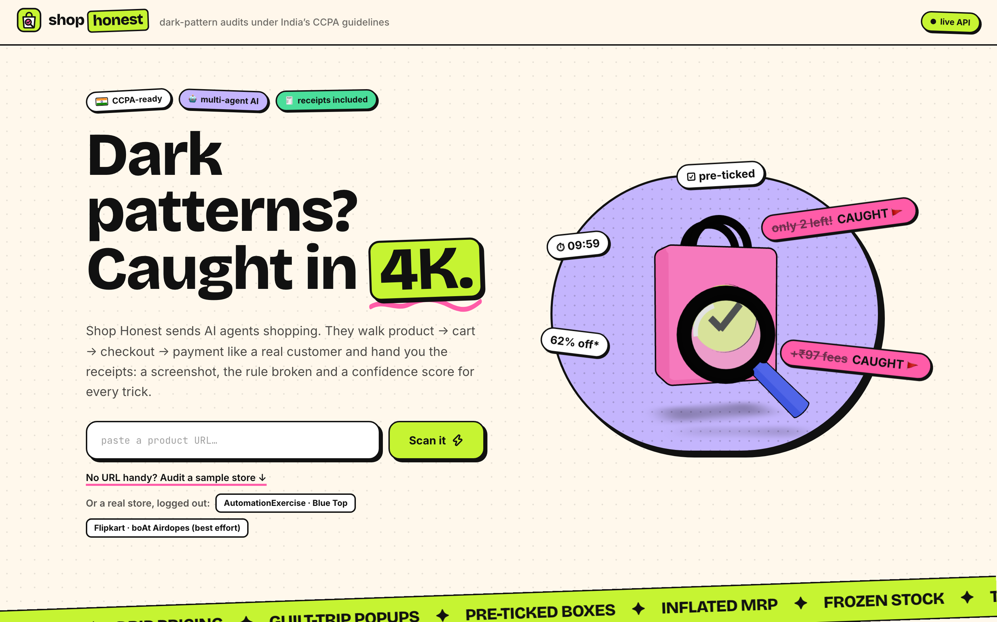
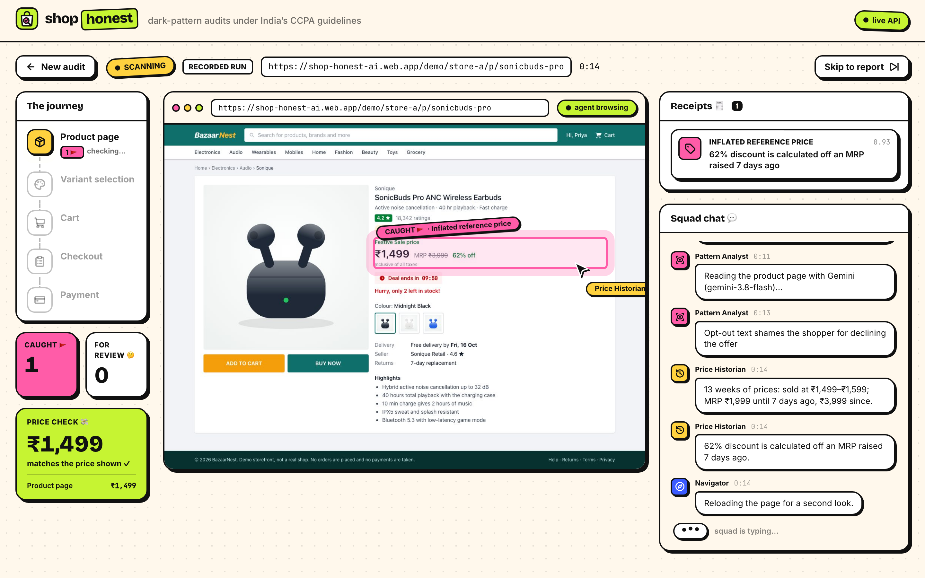
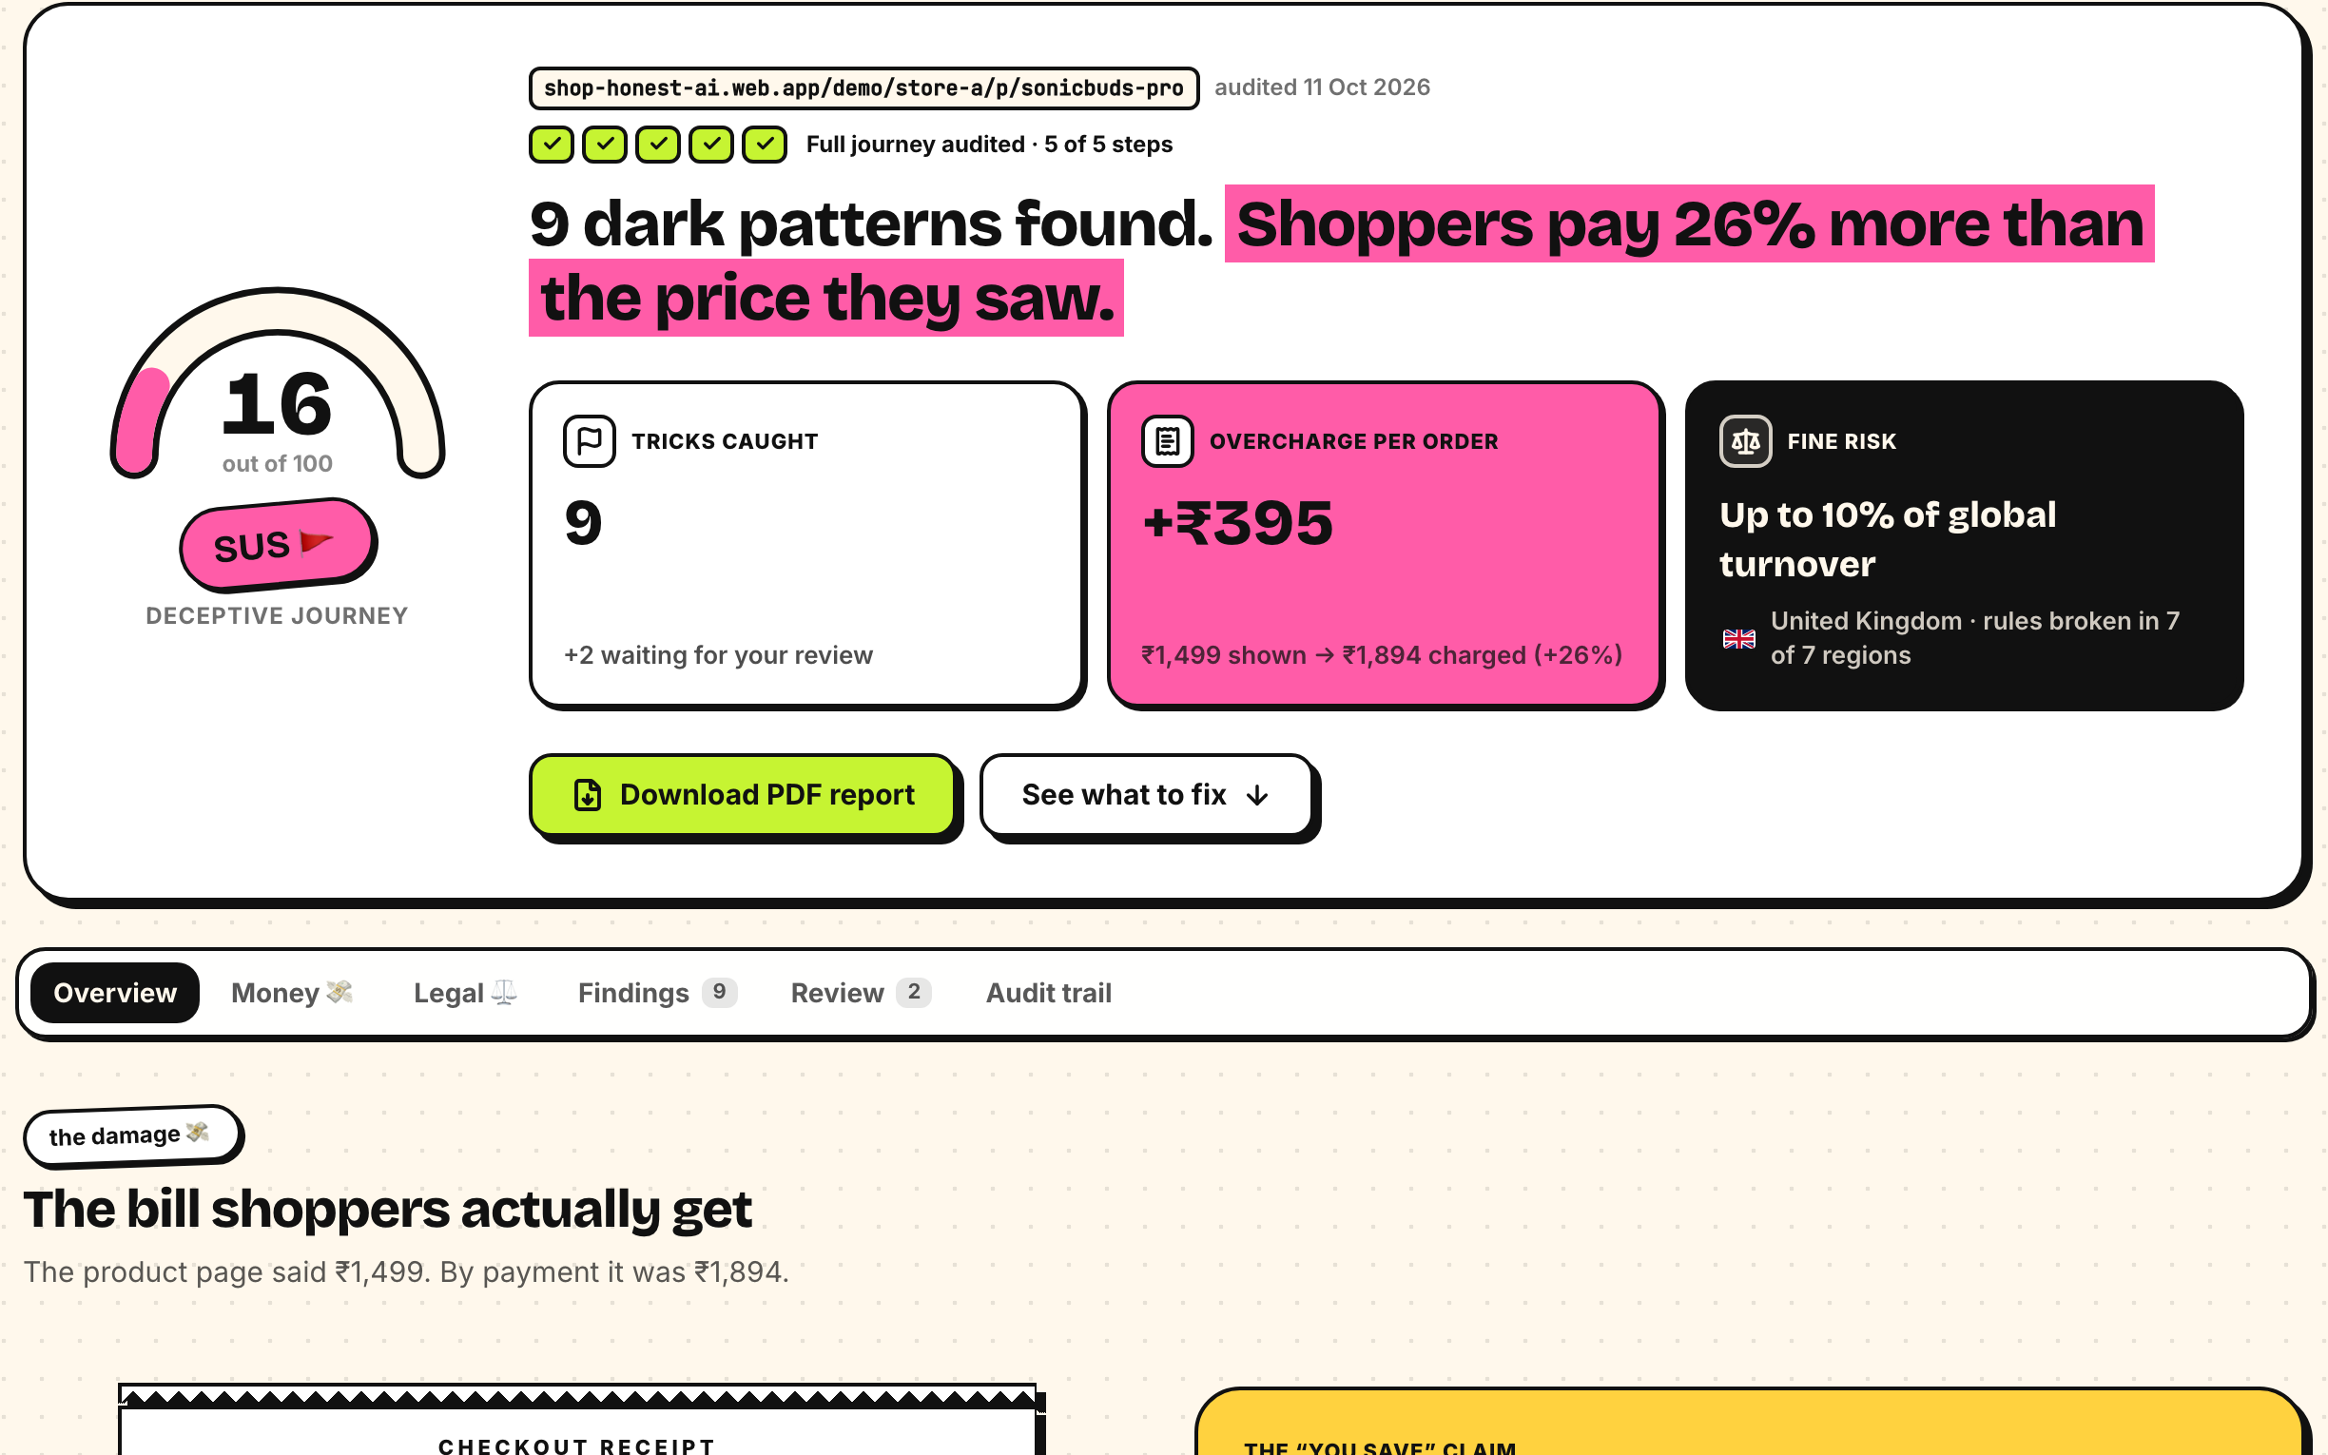
Wireframes/Mock diagrams of the proposed solution (optional)
1
Paste a URL or pick a store
2
Watch the agents shop, live
3
Get the receipts
Sample stores, or a real store like AutomationExercise or Flipkart.
Live browser, journey, receipts so far and the agents' chat.
Trust score, overcharge, fine risk, evidence and fixes. Download the PDF.
Not a mock: this is the live product. Try it at shop-honest-ai.web.app · free recorded runs, or a live run with Gemini
Notes:
Three screens: start an audit, watch the agents shop live, and read the report. These are screenshots of the deployed product, not mock-ups.

Slide 7












Architecture diagram of the proposed solution
Shopper / judge
any browser
Firebase Hosting
React app + demo stores
/api
Cloud Run
FastAPI audit runner · asia-south1
Gemini · Vertex AI
3.8 Flash; 2.5 Flash as fallback
Navigator
Playwright Chromium · click guard
live event stream (SSE), straight to Cloud Run
ADK agents
Pattern Analyst · Adjudicator
Cloud Build → Artifact Registry
image tagged with the commit · keeps the newest 3
The store
allowlisted, logged out, SSRF guard
Checks + Reporter
measured checks · score · ₹ · law
Cloud Monitoring + Billing budgets
error and 5xx alerts · daily live-run cap
Safe by design
never pays, signs in or types · budgets per audit · service account, no keys
Firestore
audits + event log (resumable)
Cloud Storage
screenshots of every step
BigQuery
price history · MRP check
Notes:
Firebase Hosting serves the React app and proxies /api to Cloud Run (FastAPI). The live event stream goes straight to Cloud Run because Hosting buffers streams. Each audit runs a Playwright Chromium navigator and ADK agents on Gemini via Vertex AI (gemini-3.8-flash, falling back to 2.5-flash). Firestore keeps audits and a resumable event log, Cloud Storage the screenshots, BigQuery the price history. Cloud Build and Artifact Registry ship images; Cloud Monitoring and billing budgets watch it.

Slide 8










Technologies to be used in the solution
AI
Gemini 3.8 Flash on Vertex AI
Google ADK agents + tools
Gemma 3 4B local dev, via Ollama
Google Cloud
Cloud Run API + browsers
Firestore audits, events
Cloud Storage screenshots
BigQuery price history
Cloud Build container builds
Artifact Registry images
Cloud Monitoring alerts, uptime
Cloud Billing budgets
Firebase Hosting web app + CDN
App
Python 3.12 + uv
FastAPI API + live stream
Playwright headless Chromium
Pydantic typed model output
React 19 dashboard
TypeScript end to end
Vite build
Tailwind CSS styling
three.js 3D hero
Notes:
AI: Gemini 3.8 Flash on Vertex AI through Google's Agent Development Kit; Gemma 3 4B via Ollama for offline development. Google Cloud: Cloud Run, Firestore, Cloud Storage, BigQuery, Cloud Build, Artifact Registry, Cloud Monitoring, Billing budgets, Firebase Hosting. App: Python 3.12, FastAPI, Playwright, Pydantic, React 19, TypeScript, Vite, Tailwind, three.js.

Slide 9






Estimated implementation cost (optional)
MONTHLY ESTIMATE live audits only; idle costs ≈ ₹0 (Cloud Run scales to zero)
PER LIVE AUDIT
≈ ₹2
1,000
audits / month
10,000
audits / month
1 lakh
audits / month
a full journey: 5 steps, about 40 seconds
₹2,000
₹20,000
₹2 lakh
Gemini 3.8 Flash
~17k in + 7k out tokens
₹1.5–2
a pilot with one platform
daily checks on 300+ products
a regulator's sweep
Cloud Run
~45 s on 2 vCPU
< ₹0.5
GUARDRAILS so a bill can't surprise anyone
100 live runs a day, site-wide
≤ 400k tokens, 40 calls per audit
Firestore · Storage · BigQuery
events, screenshots, prices
paise
6-minute limit per audit
Budget alerts at ₹2,000 / month
Replays ("Scan it")
recorded runs, no model
₹0
Keeps only the 3 newest images
Scales to zero when idle
Notes:
A live audit costs about ₹2: roughly 17k input and 7k output tokens on Gemini 3.8 Flash plus ~45 s of Cloud Run. Replays cost nothing, and Cloud Run scales to zero when idle. Estimates: ₹2,000 a month for 1,000 audits, ₹20,000 for 10,000. Guardrails: a 100-a-day live cap, per-audit token/call/time budgets, budget alerts.

Slide 10
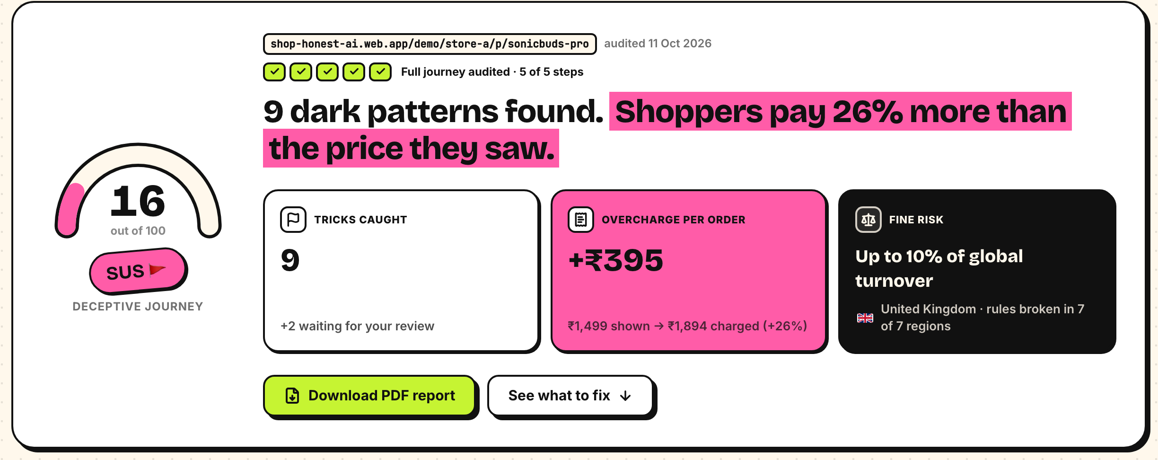
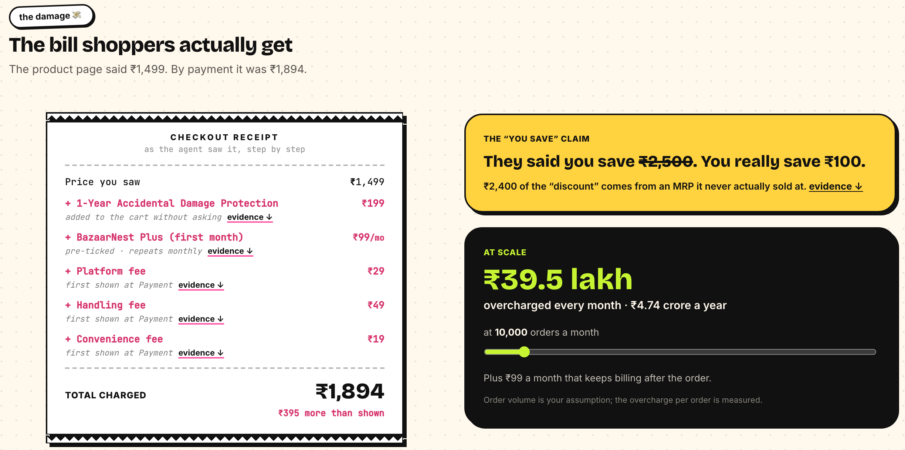
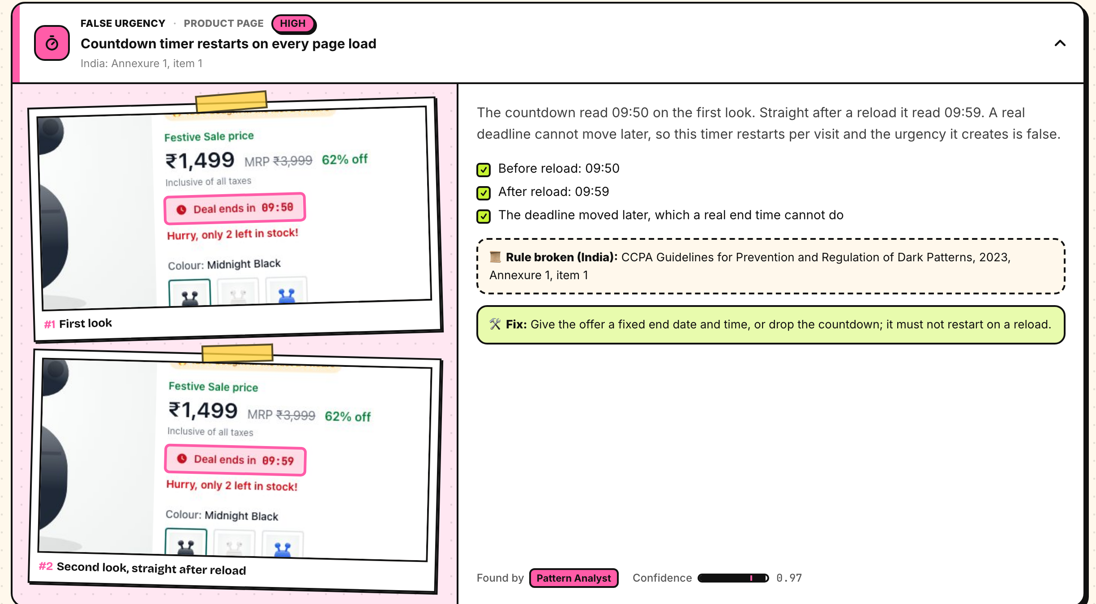
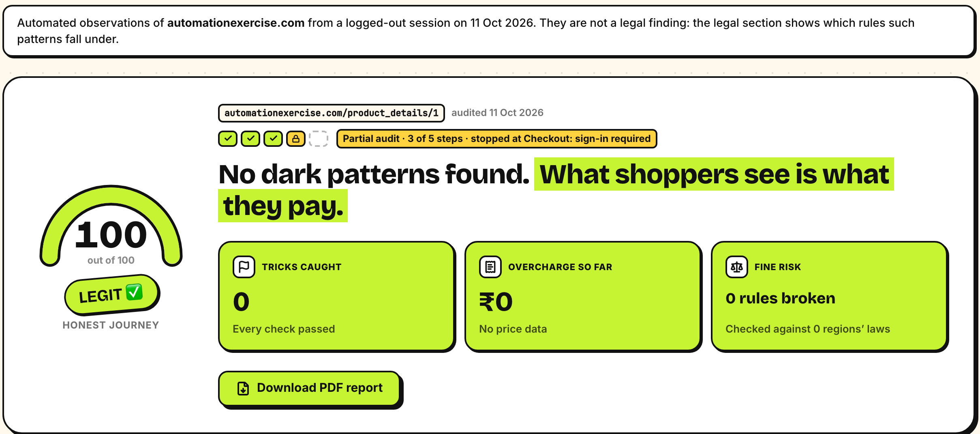
Snapshots of the prototype
Verdict: trust score, overcharge, fine risk
The bill: ₹1,499 shown, ₹1,894 charged
Evidence: the countdown restarts on reload
A real store, logged out: stops at sign-in
Notes:
Snapshots of the deployed product: the report's verdict (trust score, overcharge, fine risk), the bill shoppers actually get, one finding's evidence (the countdown restarts on reload), and a real store audited logged out that stops honestly at the sign-in wall.

Slide 11
Prototype Performance report/Benchmarking
PLANTED TRICKS live runs, 2 per store
PUBLIC DATASET 2,356 texts, F1
EVERY LAYER COUNTS Store A recall
9/9
tricks caught · Store A
the borderline claim went to human review
0
false alarms · Store B
the honest control store
0.998 precision
2 false alarms in 2,356 texts. Our model never saw this dataset; the others were trained on it.
~40 s per audit
2.5 Pro and 3.1 Pro also scored 9/9 but took 49 s and 58 s, so Flash runs both tiers.
6/6
caught before the wall · Store C
then stops honestly at sign-in
Also tested: 137 backend tests · every live event validated against the API contract · end-to-end pre-flight on production: 6/6
Notes:
Planted tricks: 9/9 on the rigged store with the borderline claim sent to review, 0 false alarms on the honest store, 6/6 before the sign-in wall. Public dataset (ec-darkpattern, Yada et al. 2022, 2,356 texts): zero-shot F1 0.962 with precision 0.998, against 0.960–0.975 for models trained on it. Ablation on Store A: measured checks 6/9, with Gemma 3 4B 8/9, with Gemini 3.8 Flash 9/9. Flash matched 2.5 Pro and 3.1 Pro and was fastest (~40 s).

Slide 12






Additional Details/Future Development (if any)
NEXT
NEXT
NEXT
Bring your own key
Logged-in journeys
Scheduled monitoring
Live audits on your own Gemini or Claude key, used for one run and never stored.
Test accounts in Secret Manager, so checkout and payment on real stores get audited too.
Nightly audits with Cloud Scheduler; an alert the day a store adds a new trick.
LATER
LATER
LATER
Shopper extension
Regulator dashboard
Apps & Indian languages
A browser extension that flags tricks while you shop, with the real price.
BigQuery + Looker Studio trends across platforms, ready for CCPA filings.
Mobile app journeys, and pages in Hindi and other Indian languages.
Notes:
Next: bring-your-own-key live audits, logged-in journeys with test accounts in Secret Manager, scheduled monitoring with Cloud Scheduler. Later: a shopper browser extension, a regulator dashboard on BigQuery and Looker Studio, mobile apps and Indian-language pages.

Slide 13


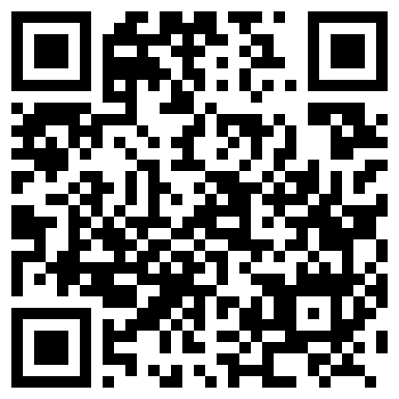

Provide links to your:
GitHub Public Repository
Demo Video Link (3 Minutes)
Final Product Link
github.com/saubhagyaashish/
shop-honest
add the video link here
shop-honest-ai.web.app
Code, docs, design decisions and evals
A 3-minute walkthrough
Sample stores, live runs and real stores
Notes:
GitHub: https://github.com/saubhagyaashish/shop-honest. Final product: https://shop-honest-ai.web.app. Demo video: add the 3-minute video link.

Slide 14


Responsible by design
The agent will never
Findings stay honest
Pay, buy now or place an order
Grounded: every claim must cite an element measured on the page.
Sign in, register or subscribe
Double-checked: a second Gemini pass on a crop of the evidence.
Type into any field
Unsure? Human review, never asserted as fact.
Accept cookies or terms (it declines or closes)
Real stores: layout-based findings go to review; reports say "not a legal finding".
Get around a CAPTCHA or bot protection
Partial audits say exactly which steps weren't seen.
Guardrails: host allowlist + SSRF guard · ad networks blocked · per-audit token and time budgets · daily cap · billing alerts
Notes:
Responsible by design: the agent never pays, signs in, types, accepts terms or bypasses bot protection. Findings must cite measured elements, are double-checked, and go to human review when unsure. On real stores, layout-based findings go to review and reports carry a not-a-legal-finding note.

Slide 15

Notes:
Thank you. Try it at shop-honest-ai.web.app.

